Slide 1
Individual Meeting
Jason Chang

Slide 2
Own Papers
First Author
PromptTSS: AAAI workshop (DL: 2024/12/01) → ICML (DL: 2025/01/31)
TimeDRL-extend: TKDE journal
Collaboration with TSMC’s faculty (ex: Sagar)
JCNet: KDD/CVPR workshop (DL: 2025/03) → NeurIPS (DL: 2025/05)
Motion/Trajectory Prediction
Collaboration
Text2Freq: NeurIPS workshop → ICML
Esun(?): KDD

Slide 3
Overtime Pay
I’ll start to file for overtime every Saturday.
Under the name of working on TKDE’s paper.
The reason is simply that I’m running out of money a little bit.
鑫淼scholarship has over.

Slide 4
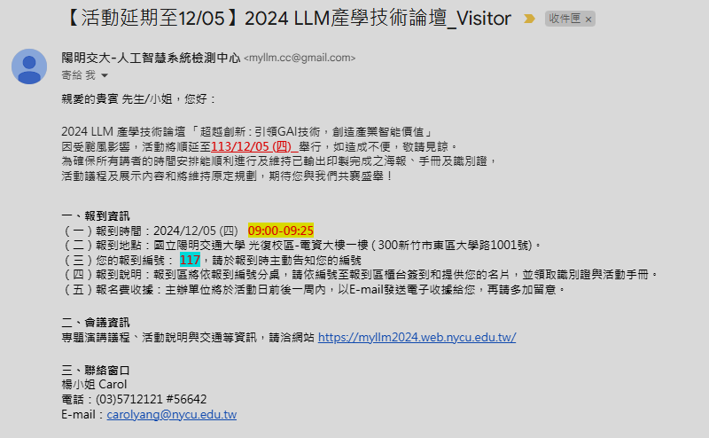
2024 LLM 產學技術論壇
連續公假五天
2024/12/05 (Thu.): 2024 LLM 產學技術論壇
2024/12/06 (Fri.): TAAI李弘毅演講
2024/12/11 ~ 13 (Wed. ~ Fri.): NeurIPS 2024

Slide 5
Thanks for your attention

